Slide 1
Programmed Cell Death
Death Signaling Pathways

Slide 2
What are the signalling pathways that
activate cell death program?
Sex hormones
?
Growth factor
?
withdrawal
?
?
Genotoxic insults
?
?
death protease
?
PCD
activation
Cell cycle perturbation
?
?
?
Genetic mutations
?
?
Death factors

Slide 3
TNF/FASL
TNF is a protein toxin which is secreted by activated macrophages and monocytes
Laster et al., using time-laspe video microscopy observed that TNF can cause target cells to adapt morphology typical of apoptosis. (1988)
A Japanese group purified a cell-killing mAb to a surface antigen called FAS that causes cytotoxic activity very similar to that caused by TNF (1989).

Slide 4
TNF/FASL
Functional and soluble forms of TNF and FasL exist as trimers.
Monovalent (Fab fragment) and divalent anti-Fas or anti-TNF antibody can not induce cell death. Only the IgM class anti-Fas or IgG3 class anti-Fas antibody that have the tendency to aggregate can activate these receptors
The receptors need to be oligomerized to be activated.

Slide 5
TNFR/FAS
In 1990, many groups simultaneously cloned two TNF receptors (TNFR1 and TNFR2).
In 1991, by expression cloning, Shige Nagata’s group cloned FAS and found that it is a surface protein with a single transmembrane domain and shares homology with TNF receptors.
An eighty amino acid domain in the cytoplasmic region of Fas and TNFR are found to be important for inducing apoptosis by mutational and deletion analysis. This domain is called “death domain”.

Slide 6
TNF Family
TNF, lymphotoxin, CD30 ligand, CD40 ligand, CD27 ligand, TRAIL, and FAS ligand.
Type II-membrane protein and the extra-cellular region of about 150 amino acids is well conserved.
Most often they can be proteolytically processed to generate soluble form. But membrane bound forms are more potent in their activity. Soluble forms often exist as trimers.

Slide 7
TNF Receptor Family
Type I membrane protein
contains 3-6 cysteine-rich domain
TNFRI and FAS have an 80-amino-acid homologous domain in their cytoplasmic tails--”death domain”

Slide 8
How do you identify the Fas or TNF death signaling pathway?
By genetic suppressor screens
By biochemical approaches such as co-IP or yeast 2 hybrid
By guessing which molecules may act downstream
All of above

Slide 9
Identification of Downstream Pathways of FAS/TNFR
1) Wallach’s and Dixit’s groups using yeast two hybrid screen isolated MORT-1/FADD. MORT-1/FADD has a “death domain” at its C terminal and a so-called “death effector” domain at the N terminal which by itself can induce PCD. MORT-1/FADD interacts with Fas through its “death domain”.
Death Effector Domain
Death Domain
1
208
FADD/Mort-1
2) Goddel’s group using similar approach isolated TRADD as the interacting protein of TNFRI. TRADD has a “death domain” but no “death effector domain”.
1
Death Domain
312
TRADD

Slide 10
Identification of Downstream Pathways of FAS/TNFR
Wallach’s group carried out one more round of the two-hybrid screen using MORT-1/FADD as a bait and isolated MACH/FLICE as a FADD-interacting protein.
Death Effector Domains
FLICE
FLICE(caspase-8) has two death-effector domains at its N-terminal right before its caspase protease domain and interacts with MORT-1/FADD through its “death-effector domain”.
TRADD can interact with MACH/FLICE through FADD

Slide 11
FAS/TNF Death Signaling Pathway
Adapted from Nagata S. Cell 1997

Slide 12
Extra Twist on the FAS Death Signaling
Peter Krammer’s group at Germany carried out a careful time-course study of Fas-induced cell death in many different cell types. They observed two different kinds of responses. In type I cells, caspase-3 activation is within 30 mins of receptor engagement, while in type II cells, caspase-3 activation was delayed for 60 mins. Fas-induced cell death in type II but not type I cells can be blocked by Bcl-2 or Bcl-XL.
Activation of FAS leads to release of Cytochrome C, which can be blocked by z-VAD-fmk, a broad range caspase inhibitor, or Bcl-2 and Bcl-xL.
Active caspase-8 can induce Cytochrome C release from mitochondria in a cell-free system in Xenopus.

Slide 13
?
Apoptosis

Slide 14
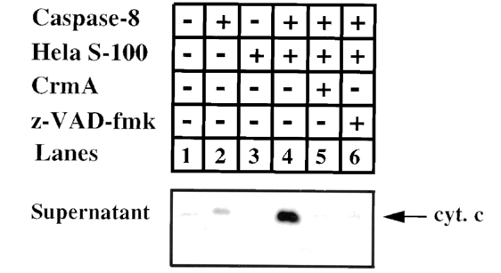
Purification of Cytochrome C releasing factor
Caspase-8+Hela S100
+purified Mitochondria
Hela S100
Cytochrome C release
Bid
?
+Caspase-8
Mitochondria
Translocate to mitochondria
BH3
Caspase-8
+
BH3
Bid
tBid
A cytoplasm protein
Adapted from Luo et al. Cell 1998

Slide 15
Two Parallel FAS Death Pathways
Adapted from Gross et al.
Gene & Development 1999

Slide 16
Death Pathways Induced by Growth Factor Deprivation
Adapted from Gross et al.
Gene & Development 1999

Slide 17
Cytochrome c release is sufficient to induce apoptosis?
Microinjection of Cytochrome C can not induce apoptosis in
certain cell types

Slide 18
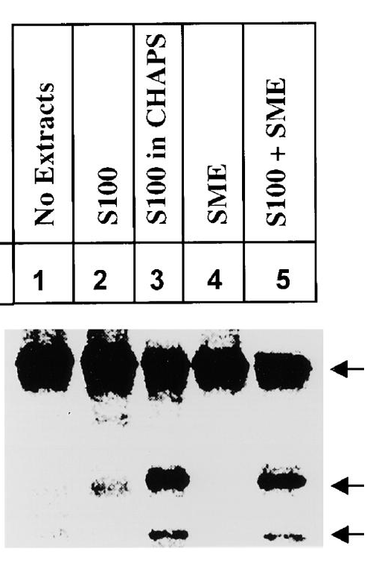
Smac--Second Mitochondria Derived Activator of Caspases
Hela S100 prepared with buffer containing detergents
is more active in activating caspases
SME
(solubilized membrane extract)
+S100
Pro-caspase-3
SMAC
(mitochondria protein)
Cleaved products
Adapted from Du et al. Cell 2000

Slide 19
SMAC and IAPs
SMAC encodes a novel protein.
SMAC interacts with IAP proteins
Members of IAP family directly inhibit the activation and protease activities of caspases
SMAC removes the inhibition of IAPs on caspases.

Slide 20
IAP Family
First identified in the baculovirus genome as inhibitors of apoptosis.
All contains at least one BIR domain (baculovirus IAP repeat).
Some family members (XIAP, cIAPs, Survivin, DIAP1) are potent inhibitors of apoptosis, by inhibiting the activation or activities of some caspases (caspase-3, caspase-7 and caspase-9).
Some family members regulate Chromosome segregation and cytokinesis.
Survivin is upregulated in many cancer cells but not in differentiated cells, making it a new tumor marker.

Slide 21
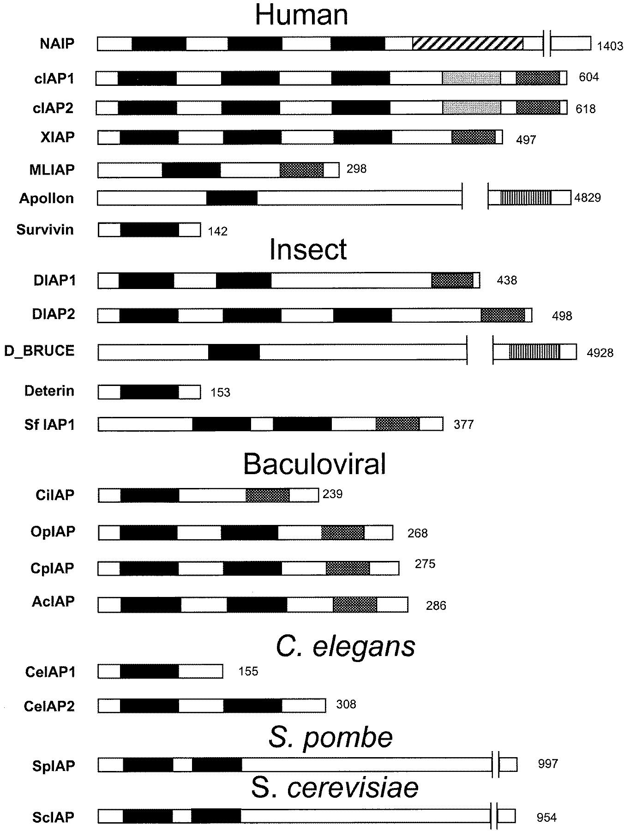
IAP Family

Slide 22
How does SMAC inhibit IAPs?
++
-
-
-
-
-
-
-
++

Slide 23
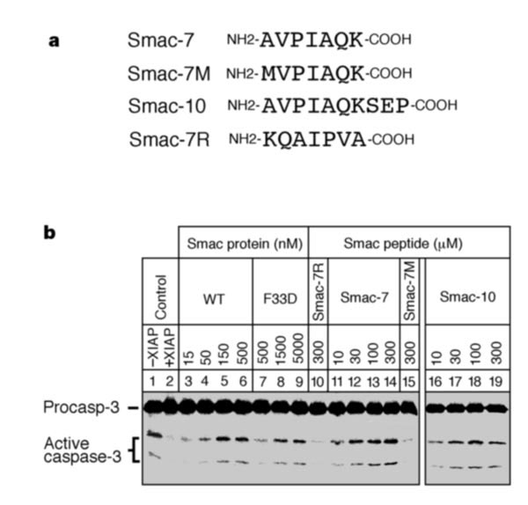
Amino terminal 7 AA is sufficient to confer SMAC activity

Slide 24
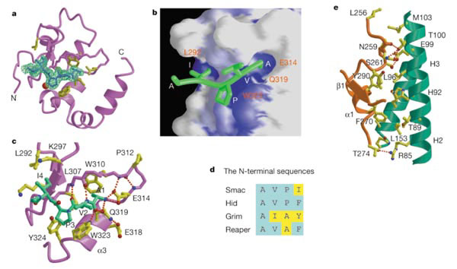
Structure of SMAC peptide/XIAP

Slide 25
SMAC Working Model
casp-9 activation
IAP
No casp-9 activation
IAP
SMAC
IAP
casp-9 activation

Slide 26
SMAC/Rpr/_x0008_Grim/Hid Define a New Family of Cell Death Activators
Play partially redundant roles in mediating apoptosis in Drosophila.
Have no sequence similarity among one another except N-terminal 14 amino acid sequences
N-terminal 14 amino acid peptide is sufficient to induce cell death.
Interact directly with fly DIAP proteins to activate fly caspases.

Slide 27
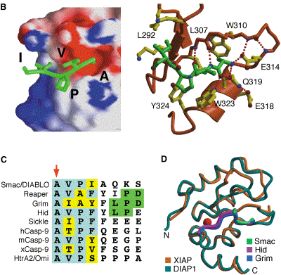
Structure and sequence similarity among SMAC/Rpr/_x0008_Grim/Hid

Slide 28
Radiation-_x0008_Induced Cell Death in Drosophila
Radiation
DNA damage
p53 activation
Fly caspases
Diap
Reaper
Grim
Hid
Cell death

